Slide 1

Organizational Behavior
(MGT-502)
Lecture-4

Slide 2
Summary of
Lecture-3

Slide 3
Organization
A systematic arrangement of people to accomplish some specific purpose.
VU
Govt. Agencies
Glossary Store
Steel Mills
Hospitals
United Nations

Slide 4
Organizations as Systems
Task environment:
Competitors
Unions
Regulatory agencies
Clients
Structure
Inputs:
Material
Capital
Human
Outputs:
Products
Services
Task
Technology
People
(Actors)
Organizational Boundary

Slide 5
How does an Organization Create Value?

Slide 6
Management and Myths
What Managers can do and what Managers can’t do when managing people, organizations and society.

Slide 7
Today’s Topics

Slide 8

Managerial Perspectives on Organizational Behavior
Organizational behavior is not a designated function or area. Rather, it is a perspective or set of tools that all managers can use to carry out their jobs more effectively.

Slide 9
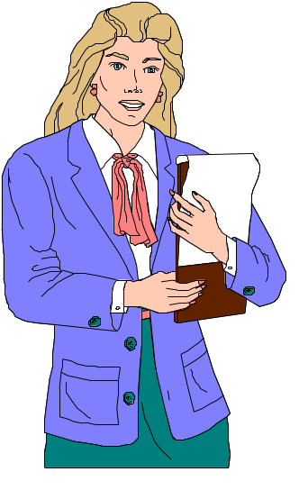
A Knowledge of Organizational Behavior Helps Managers:
Better Understand the Behavior of Those Around Them
Better Interact with Colleagues, Peers, and Co-Workers
Better Understand the Basic Issues of Leadership
Better Interact with Suppliers, Customers, and Competitors

Slide 10

Understanding Work Behavior
Personal
Environment
Heredity
Manager’s Role Includes:
  Observing and recognizing the differences
  Studying relationships between variables that influence individual behavior
  Discovering and predicting relationships

Slide 11
Part-I The Individual
Ability & Learning
Values, Attitudes and Job Satisfaction
Personality & Emotions
Perception & Individual Decision Making
Basic Motivation Concepts
Motivation and its Applications

Slide 12
Understanding the Basics of Human Behavior

Slide 13
Heredity
Environment
Individual
Differences
Framework
Abilities
and Skills
Values
Work-Related
Attitudes
Work-Related
Behaviors

Slide 14

Demographic Factors
Demographic factors include a number of individual differences that influence behavioral choices
Nationality
Race
Age
Socioeconomic Background
Educational Attainment
Gender

Slide 15
Biographical
Characteristics
Age
Gender
Tenure
Marital
Status

Slide 16
Variables Influencing
Individual Behavior

Slide 17
The Person
Skills & abilities
Personality
Perceptions
Attitudes
Values
Ethics
The Environment
Organization
Work group
Job
Personal life
Behavior
B = f(P,E)

Slide 18
Individual Differences
To Understand Individual Differences a Manager Must
Observe and
recognize the
differences
Study relationships
between variables
that influence
individual
behavior
Discover
relationships

Slide 19
Why focus on individuals?

Slide 20
A lot of athletes say they want to be part of a cohesive team—but they also want their name printed on the back of their jerseys in 6-inch-high block letters.
-S.P.Robbins

Slide 21
Personality
Self-concept
Internal processes
Values
Attitudes
Emotions
Abilities
Behavior

Slide 22
Individual Differences
Individual Differences
  Personal attributes that vary from one person to another.
  Individual differences include personality, attitudes, perception, and creativity.

Slide 23
Model of Organizational Behavior
Independent variables
  Individual
  Group
  Organizational
Dependent variables
  Attitudinal
  Performance-related

Slide 24
Productivity
Absenteeism
The
Dependent
Variables
Turnover
Organizational
Citizenship
Job Satisfaction

Slide 25
MARS model of behaviour and performance
Role
perceptions
Motivation
Individual
behaviour and
performance
Ability
Situational
factors

Slide 26
Employee ability
Natural aptitudes and learned capabilities required to successfully complete a task
  competencies − personal characteristics that lead to superior performance
  person − job matching
    select qualified people
    develop employee
    abilities through training
    redesign job to fit
    person's existing abilities
R
M
BAR
A
S

Slide 27
Employee role perceptions
Beliefs about what behaviour is required to achieve the desired results:
  understanding what tasks to perform
  understanding relative importance of tasks
  understanding preferred behaviours to accomplish tasks

Slide 28
Situational factors
Environmental conditions beyond the individual’s short-term control that constrain or facilitate behaviour
  time
  people
  budget
  work facilities

Slide 29
Types of work-related behaviour
Joining the
organisation
Types of
work-related
behaviour
Exhibiting
organisational
citizenship
Remaining
with the
organisation
Performing
required
tasks
Maintaining
work
attendance

Slide 30
Performance

Slide 31
Why Do We Care?
Ability
PERFORMANCE
Opportunity
Motivation
Performance =
f (Ability, Motivation, Opportunity)

Slide 32
The Psychological Contract
Contributions from the Individual
Inducements from the Organization
- Effort
- Ability
- Loyalty
- Skills
- Time
- Competencies
- Pay
- Job Security
- Benefits
- Career Opportunities
- Status
- Promotion Opportunities

Slide 33

The Person-Job Fit
Person-Job Fit
  The extent to which the contributions made by the individual match the inducements offered by the organization.

Slide 34
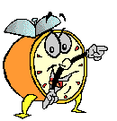
Let’s stop it here

Slide 35
Summary

Slide 36
Understanding the Basics of Human Behavior

Slide 37
Variables Influencing
Individual Behavior

Slide 38
The Person
Skills & abilities
Personality
Perceptions
Attitudes
Values
Ethics
The Environment
Organization
Work group
Job
Personal life
Behavior
B = f(P,E)

Slide 39
Types of work-related behaviour
Joining the
organisation
Types of
work-related
behaviour
Exhibiting
organisational
citizenship
Remaining
with the
organisation
Performing
required
tasks
Maintaining
work
attendance

Slide 40
Next….

Slide 41
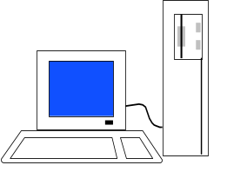
Challenges to Organizations
Globalization
Diversity
Technology
Ethics

Slide 42
Organizational Behavior
(MGT-502)
Lecture-4

